Slide 1
CS 0449 Recitation
Gordon Lu

Slide 2


Introduction
Cool kid
Data Science
Gamer
12th time TAing any class
Before Office Hours
After Office Hours

Slide 3


Plans for Today
Nothing
Linux/Thoth Tutorial
Logic Puzzles
  SoP/PoS
IEEE 754

Slide 4
Linux Tutorial

Slide 5


Linux/Thoth Setup
For Windows/Mac, you can ssh into thoth from cmd:
Let’s go over SFTP setup now…
I’ll set it up for Atom, for convenience

Slide 6

SCP: Secure Copy Protocol
We could use programs like FileZilla or CyberDuck to transfer files…
BUT
SCP is also easy to do:

Slide 7

SCP Examples
1) Local to remote
2) Remote to Local

Slide 8
Logic Puzzles

Slide 9

Let’s get one thing straight…
Bit manipulation puzzles are TOUGH
Going over binary/logical operators won’t clear much…
Let’s go over some problems instead!

Slide 10
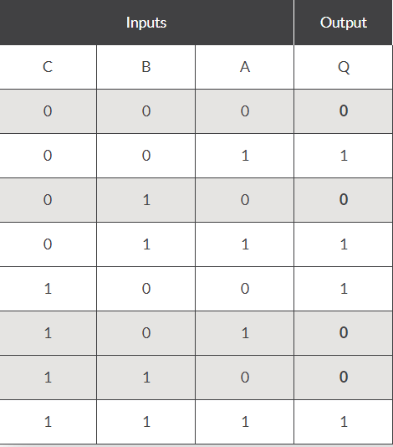
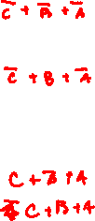
Example 1

Slide 11
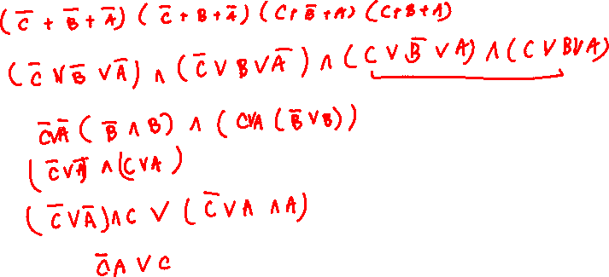
Solution:

Slide 12
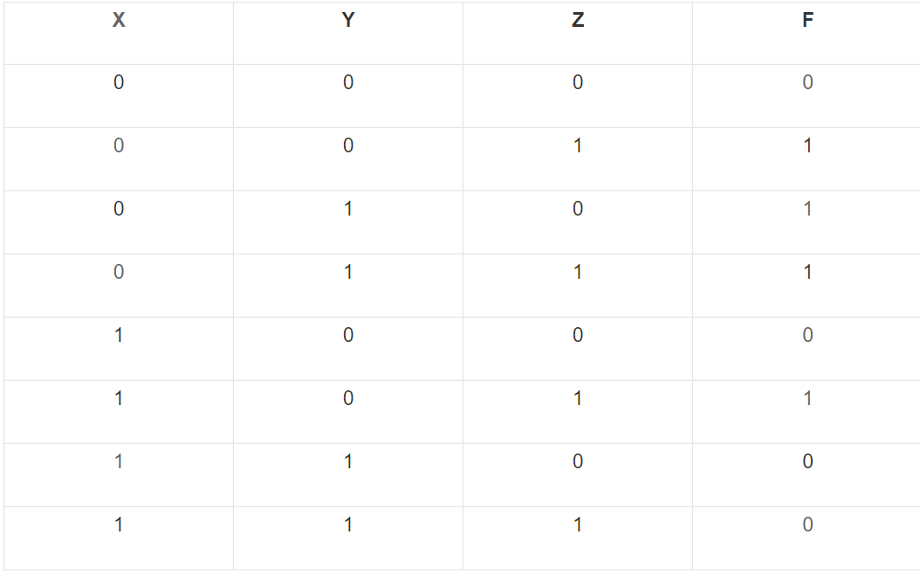
Example 2

Slide 13
Solution:

Slide 14
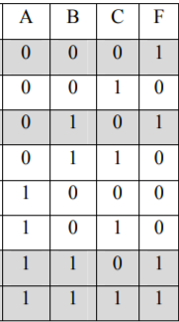
Example 3

Slide 15
Solution:

Slide 16
IEEE 754

Slide 17


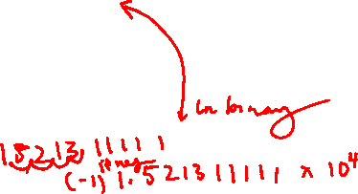
Fixed-Point Representation
Formally,
Let $x∈ℝ$ (Binary).
Then, x can be uniquely written as:
$$x=σ\overline{x}+2^{e}$$
where $σ=Sign Bit$
$$1≤x<(10)_{2}$$
$$e∈ℝ$$

Slide 18

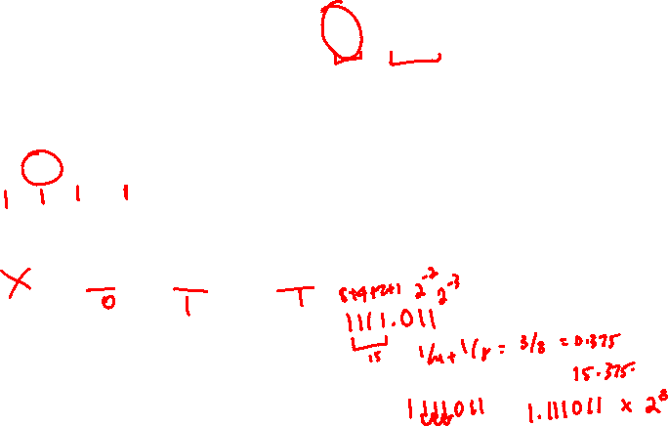
Convert 15.375 to Binary
Apply Conversion of Bases
1) For the Decimal portion:
1 = 3/2 = 7/2 = 15/2
Mark each bit that is odd as a 1, otherwise mark it as 0.
15 -> 1111 in binary
2) For the Fractional portion:
0.375 * 2 = 0.750 * 2 = (1.500 – 1) * 2 = 1.000
Mark each number that did not exceed 1 with a 0, and 1 otherwise.
0.375 -> 011 in binary.
Therefore, 15.375 is 1111.011 in Binary!

Slide 19
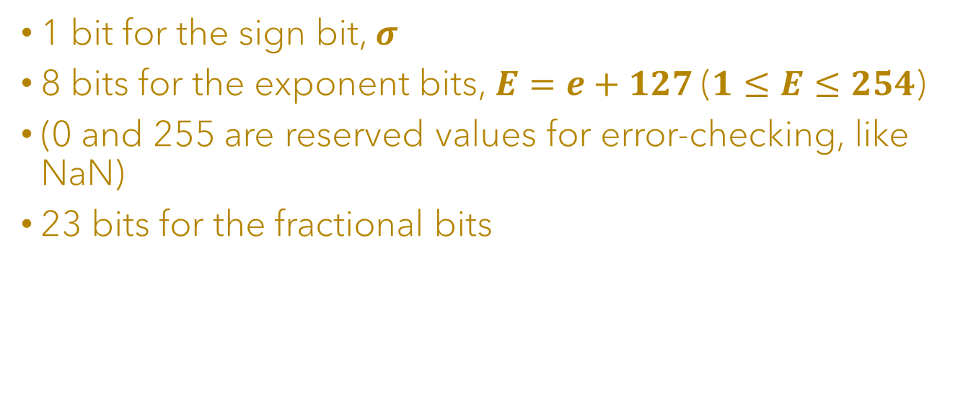
IEEE Single Precision
1 bit for the sign bit, $σ$
8 bits for the exponent bits,$E=e+127$ ($1≤E≤254$)
(0 and 255 are reserved values for error-checking, like NaN)
23 bits for the fractional bits

Slide 20

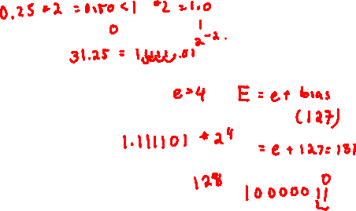
31.25 in IEEE 754
Apply conversion of bases on decimal part:
1) 1 = 3/2 = 7/2 = 15/2 = 31/2
31 = 11111 in Binary.
Apply conversion of bases on fraction part:
1) (0.25 * 2) = 0.50 * 2 = 1.00
0.25 = 01 in Binary
In binary, 31.25 = 11111.01
Write in terms of Scientific Notation: $±1.111101 ∗2^{4}$
$$σ=0$$
$e=4→E=127+4=131=10000011$ in binary

Slide 21


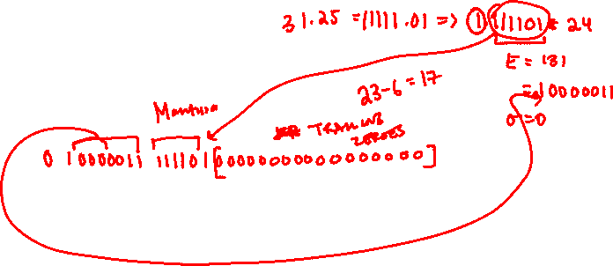
31.25 in IEEE 754
Fractional Bits
Therefore, in IEEE 754:
0 | 1 | 0 | 0 | 0 | 0 | 0 | 1 | 1 | 1 | 1 | 1 | 1 | 0 | 1 | 0 | 0 | 0 | 0 | 0 | 0 | 0 | 0 | 0 | 0 | 0 | 0 | 0 | 0 | 0 | 0 | 0
Sign Bit, $σ$
E = e + 127
Trailing Zeros

Slide 22

Another Example
What is the correct value encoded by the following floating-point number?
0b 0 10000000 11000000000000000000000
Signed bit is 0, so it’s positive
Exponent can be calculated as so: 1000 0000 – 0111 1111 = 1
Mantissa is: 1.11
Thus, we have: $+{1.11}_{2}∗2^{1}$
$2^{1}+2^{0}+2^{−1}=3.5$

Slide 23

Questions?

